Slide 1
Processes

Slide 2
Process
Operating system provided abstraction to represent what is needed to run a single program
The unit of execution
Multiple Parts
The Program Code, Also Called Text Section
Current Activity Including the current values of PC, Registers
Stack Containing Temporary Data
Function Parameters, Return Addresses, Local Variables
Data Section Containing Global Variables
Heap Containing Memory Dynamically Allocated During Run Time

Slide 3
What is a program?
A Program is an executable file that contains:
Code: Machine Instructions
Data: Variables Stored And Manipulated In Memory
initialized variables (globals)
dynamically allocated variables (malloc, new)
stack variables (C automatic variables, function arguments)
Process != Program
Example:
We can run 2 instances of Mozilla Firefox:
Same program
Separate processes

Slide 4
An analogy baking a cake
Need a cake recipe and a kitchen well stocked with all the input: flour, eggs, sugar ….
the recipe is the program (i.e., an algorithm expressed in some suitable notation),
the baker is the processor (CPU),
and the cake ingredients are the input data.
The process is the activity consisting of the baker reading the recipe, fetching the ingredients, and baking the cake.

Slide 5
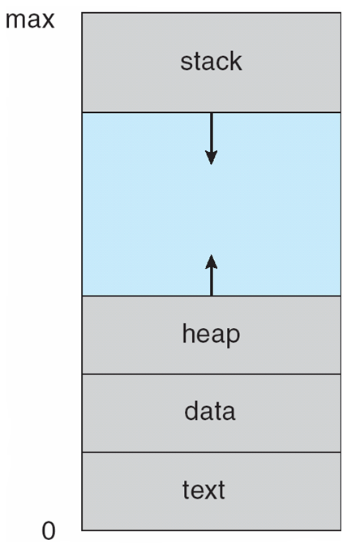
Process in Memory
Program becomes process when executable file loaded into memory
Execution of program started via GUI mouse clicks, command line entry of its name, etc.
Process address space
set of all memory addresses accessible by a process

Slide 6
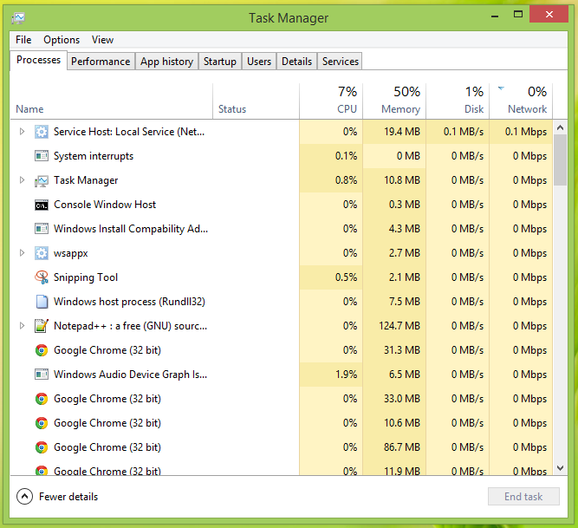

Slide 7
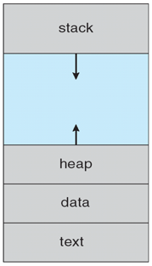
How Program Becomes Process
When a program is launched
OS loads program into memory
Creates kernel data structure for the process
Initializes data
Starts from an entry point (e.g., main())
Executable
101010101010101010101010101010101010101010101010
OS
Stack
a.out
Loader
Main Memory
Unused
Address
Space
Data
Text

Slide 8
Recall: What happens during execution?
Addr 2³²-1
R0
…
R31
F0
…
F30
PC
…
Data1
Data0
Inst237
Inst236
…
Inst5
Inst4
Inst3
Inst2 Inst1
Inst0
Fetch
Exec
Execution sequence:
Fetch Instruction at PC
Decode
Execute (possibly using registers)
Write results to registers/mem
PC = Next Instruction(PC)
Repeat
PC
PC
PC
PC
Addr 0

Slide 9
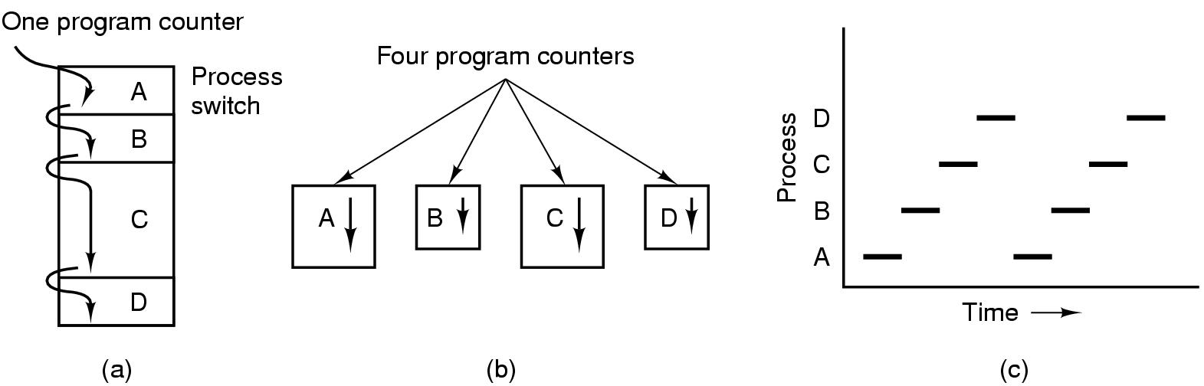
Multiprogramming
Multiprogramming Of 4 Processes in a Single CPU
CPU switches from one process to other process
Only One Physical Program Counter, 4 Logical Program Counter.
Conceptual Model Of 4 Independent, Sequential Processes
Only One Program Active At Any Instant.
Real Life Analogy? - A Daycare Teacher Trying To Feed 4 Infants.

Slide 10
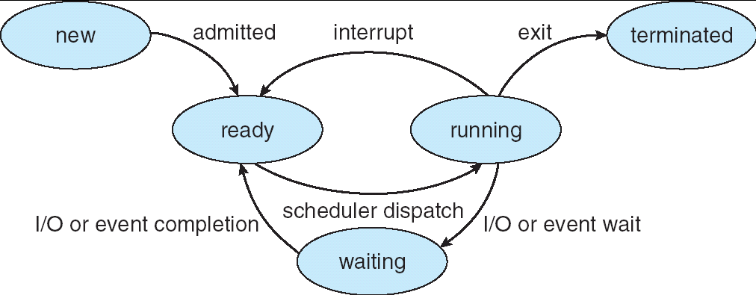
Lifecycle of a Process
As a process executes, it changes state
new: The process is being created
ready: The process is waiting to run
running: Instructions are being executed
waiting: Process waiting for some event to occur
terminated: The process has finished execution

Slide 11
Process Data Structures
OS represents a process using a Process Control Block (PCB)
Has all the details of a process
Context of the process
Process Id
Security Credentials
Process State
Username of owner
General Purpose Registers
Queue Pointers
Stack Pointer
Signal Masks
Program Counter
Memory Management
Accounting Info
…

Slide 12
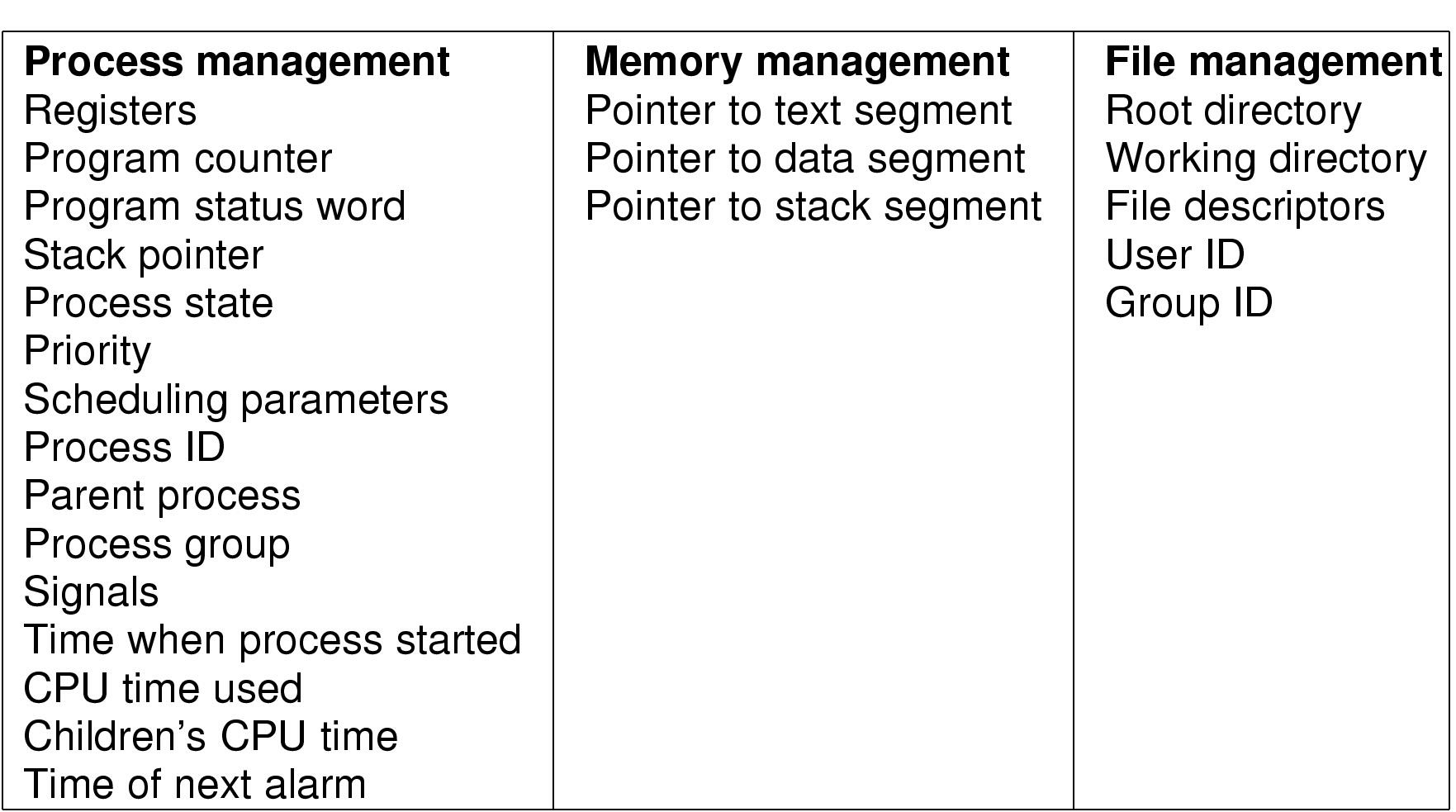
Process Control Block (PCB)
Figure: Fields of a PCB

Slide 13
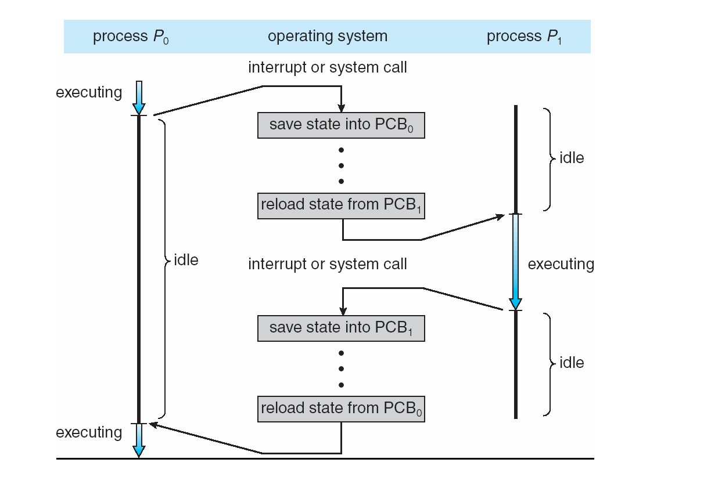
CPU Switch From Process to Process

Slide 14
Context Switch
For a running process
All registers are loaded in CPU and modified
E.g. Program Counter, Stack Pointer, General Purpose Registers
When process relinquishes the CPU, the OS
Saves register values to the PCB of that process
To execute another process, the OS
Loads register values from PCB of that process
Context Switch
Process of switching CPU from one process to another
Very machine dependent for types of registers

Slide 15
Context Switch
Overheads: CPU is idle during a context switch
Explicit:
direct cost of loading/storing registers to/from main memory
Implicit:
Opportunity cost of flushing useful caches (cache, TLB, etc.)
Wait for pipeline to drain in pipelined processors

Slide 16
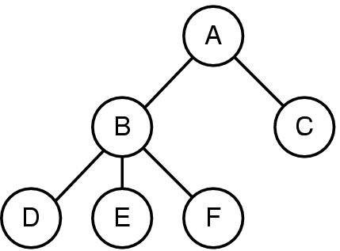
Process Hierarchies
When process A creates process B, A is called the “parent” process, B is the “child”
Forms a hierarchy
UNIX calls this a "process group“
Windows has NO process hierarchy
Processes are independent after
creation

Slide 17
What does it take to create a process?
Must construct new PCB
Inexpensive
Must set up new address space
More expensive

Slide 18
Process Overheads
A full process includes numerous things:
an address space (defining all the code and data)
OS resources and accounting information
a “thread of control”,
defines where the process is currently executing
That is the stack and registers
Creating a new process is costly
all of the structures that must be allocated
Context switching is costly
Implicit and explicit costs as we talked about

Slide 19
Need something more lightweight
What’s similar in these processes?
They all share the same code and data (address space)
They all share the same privileges
They share almost everything in the process
What don’t they share?
Each has its own PC, registers, and stack
Idea: why don’t we separate the idea of process (address space, accounting, etc.) from that of the minimal “thread of control” (PC, stack, registers)?

Slide 20
Threads and Processes
Most operating systems therefore support two entities:
the process,
which defines the address space and general process attributes
the thread,
which defines a sequential execution stream within a process
A thread is bound to a single process.
For each process, however, there may be many threads.
Threads are the unit of scheduling
Processes are containers in which threads execute

Slide 21
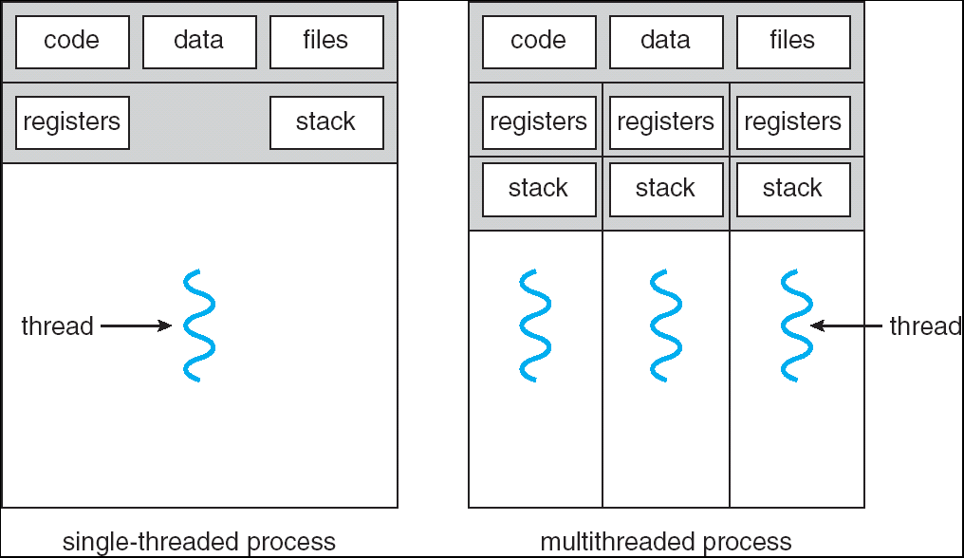
Multithreaded Processes

Slide 22
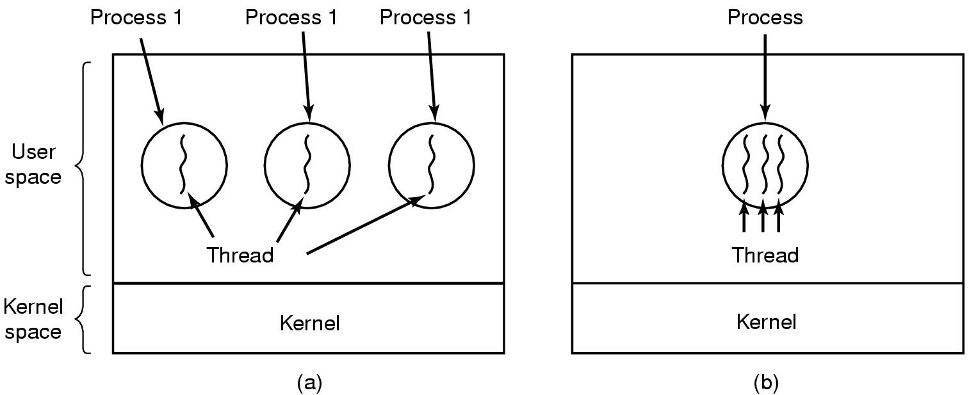
Threads
Environment (resource)
execution
(a) Three processes each with one thread
(b) One process with three threads

Slide 23
The Thread Model
Shared information
Address space: text, data structures, etc
I/O and file: comm. ports, directories and file descriptors, etc
Global variables and child processes.
Accounting info: stats
Private state
State (ready, running and blocked)
Registers
Program counter
Execution stack
Each thread execute separately

Slide 24
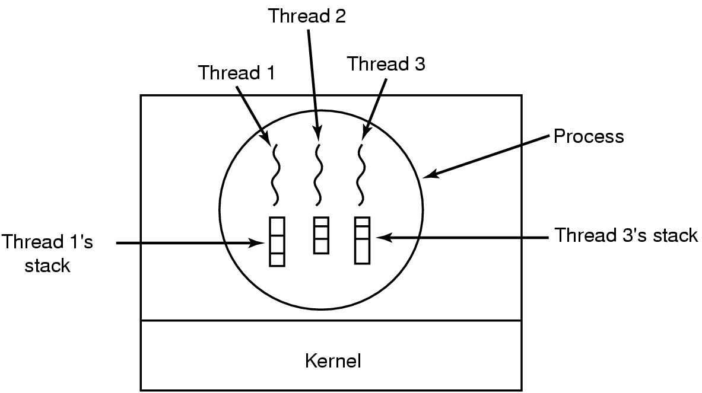
Why each thread has its own stack?
What will happen if they share one stack?
Each thread call different procedures and each has a different execution history.

Slide 25
Thread Context Switch
Multiplex multiple threads on single CPU
Similar to process context switch, but less expensive
Still needs to switch register set
But no memory management related work!!!

Slide 26
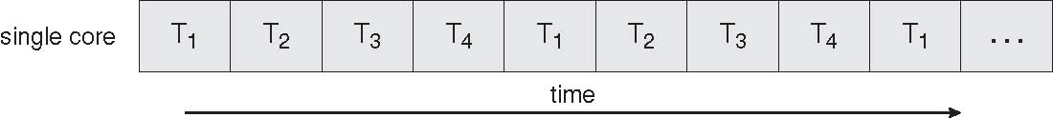
Concurrent Execution on a Single-core System

Slide 27
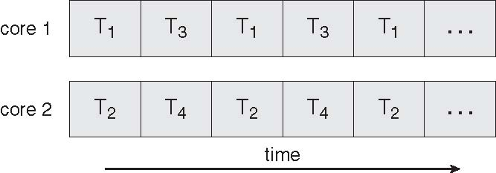
Parallel Execution on a Multicore System

Slide 28
Thread Dynamics
Threads are dynamically created/terminated
Multiple threads need to be scheduled
Ready
Blocked
Running
Terminated
Threads share CPU and on single processor machine only one thread can run at a time

Slide 29
Thread Usage
Why need threads?
Simplify coding
Concurrent activities within a process
Better CPU utilization
Better responsiveness
Less costly to create & switch
Utilizing parallelism of multi-processor systems

Slide 30
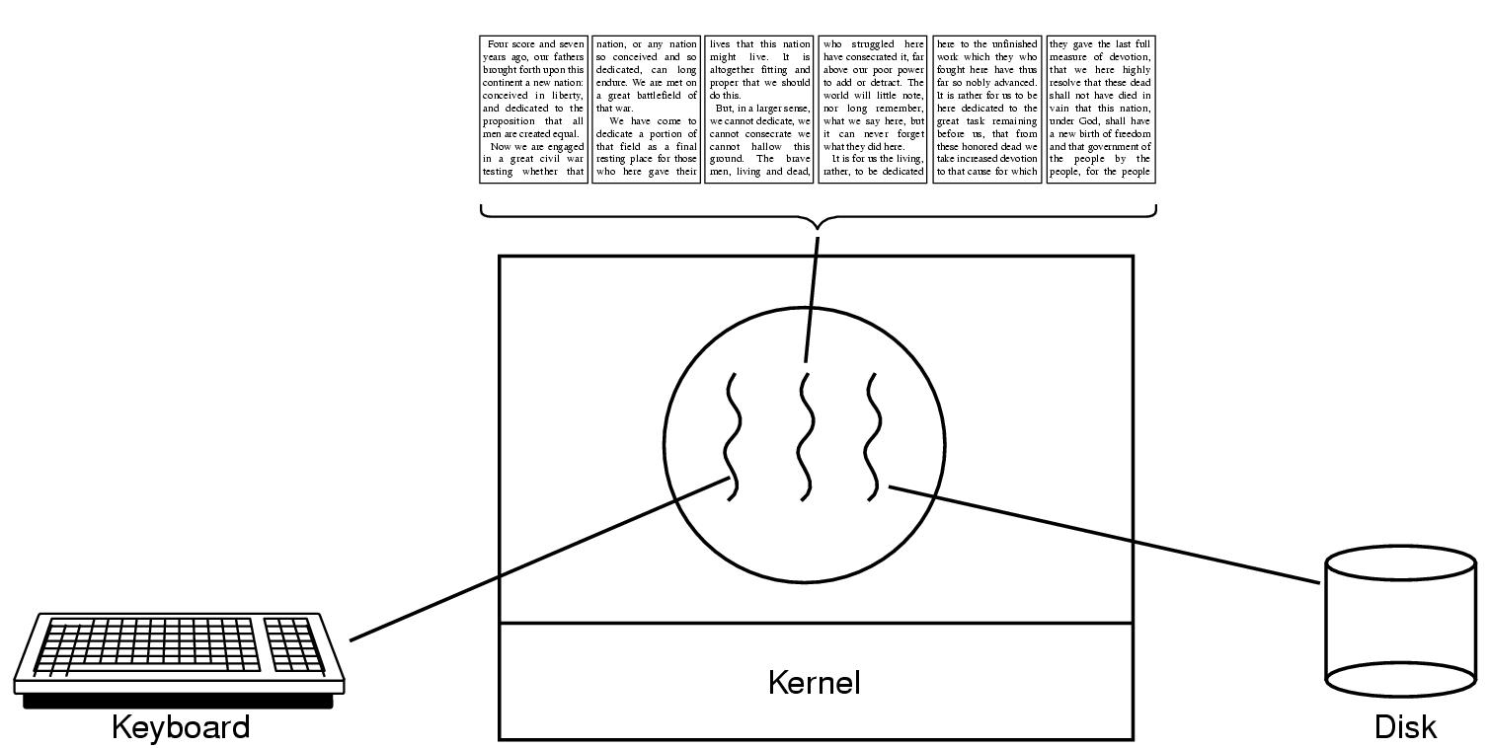
Thread Usage: word processor
A thread can wait for I/O, while the others can still be running.
What if it is single-threaded?

Slide 31
Thread Usage: Web Server
How does one server serves multiple requests
Requests come asynchronously
Each request takes variable amount of time.

Slide 32
Thread Usage: Web Server
Single process, single thread
for(;;){
wait_for_request();
handle_request();
}
Problem?

Slide 33
Thread Usage: Web Server
Multi-process
for(;;){
wait_for_request();
child_pid = fork();
if(child_pid==0) {
handle_request(); exit(0);
}
}
Problem?

Slide 34
Thread Usage: Web Server
Multi-thread
for(;;){
wait_for_request();
//create a thread to handle request
}
Problem?

Slide 35
Thread Usage: Web Server
Thread pool
//create multiple worker threads first
for(;;){
wait_for_request();
//pass request to one worker thread
}

Slide 36
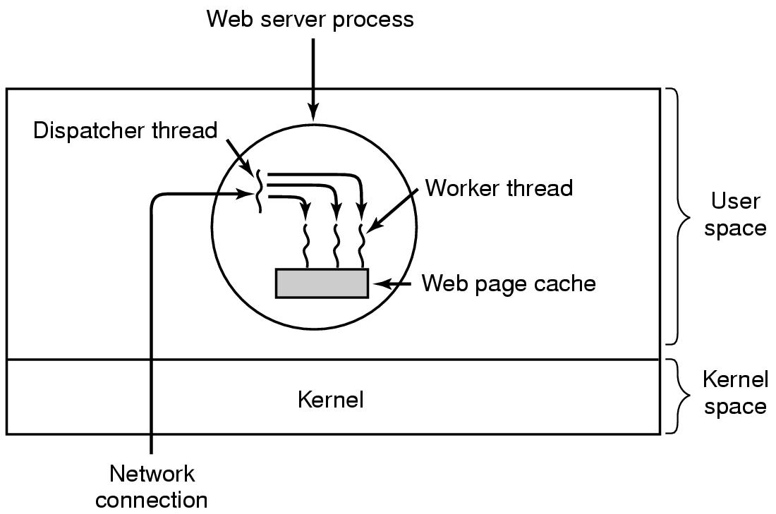
Thread Usage: Web Server

Slide 37
Blocking System Calls
Usually I/O related: read(), fread(), getc(), write()
Doesn’t return until the call completes
The process/thread is switched to blocked state
When the I/O completes, the process/thread becomes ready
Simple to implement

Slide 38
Thread Implementation
In user space
Kernel unaware of multiple threads
User level runtime system does scheduling
In kernel space
Kernel supports threads (lightweight process)

Slide 39
User-Level Threads
The thread scheduler is part of a user-level library
Each thread is represented simply by:
PC
Registers
Stack
Small control block
All thread operations are at the user-level:
Creating a new thread
switching between threads
synchronizing between threads

Slide 40
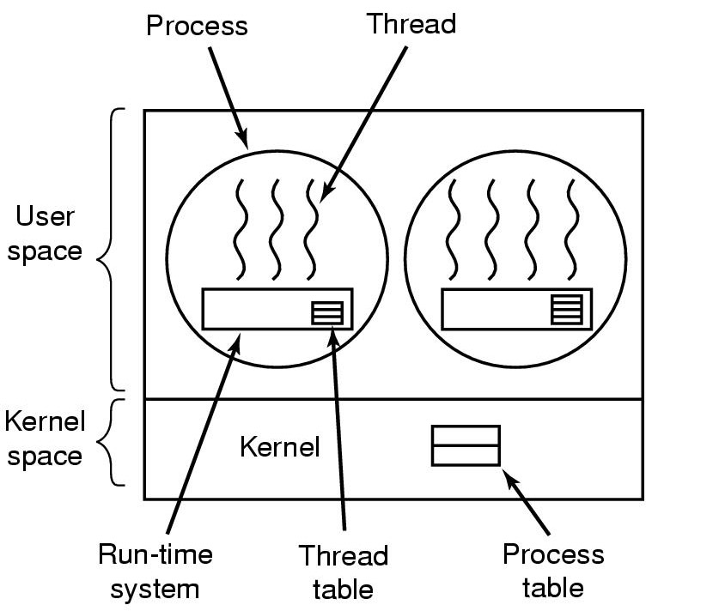
Implementing Threads in User Space
A user-level threads package

Slide 41
User-level Threads
Advantages
Fast Context Switching:
Switching entirely in user mode – local procedures.
No need to trap to kernel, no memory flush;
Customized Scheduling
Disadvantages
Blocking
Any user-level thread can block the entire task executing a single system call (page fault is similar case).
No protection, threads are expected to be polite to share CPU.
Uncooperative/buggy threads may monopolize CPU.

Slide 42
Kernel Threads
Kernel threads may not be as heavy weight as processes, but they still suffer from performance problems:
Any thread operation still requires a system call.
The kernel doesn’t trust the user
there must be lots of checking on kernel calls

Slide 43
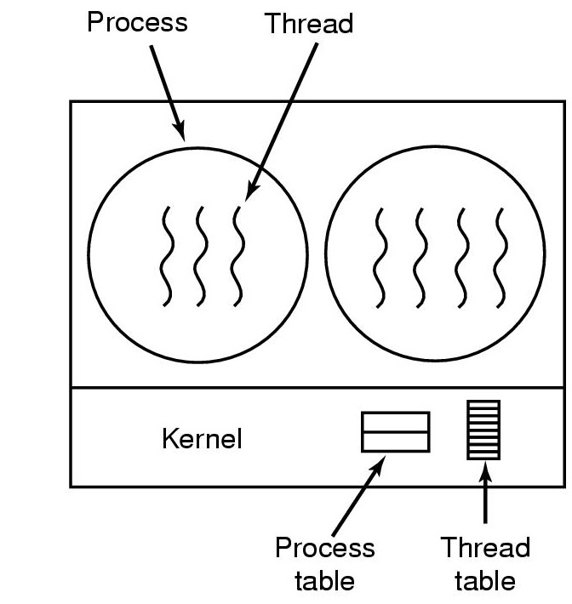
Implementing Threads in the Kernel
A thread package managed by the kernel

Slide 44
Kernel-Level Threads
Advantages:
Kernel aware of threads, if one thread blocks, can schedule another thread in the process.
Disadvantages:
Context switch is more expensive.

Slide 45
User-Level vs. Kernel Threads
User-Level
Managed by application
Kernel not aware of thread
Context switching cheap
Create as many as needed
Must be used with care
Kernel-Level
Managed by kernel
Consumes kernel resources
Context switching expensive
Number limited by kernel resources
Simpler to use

Slide 46
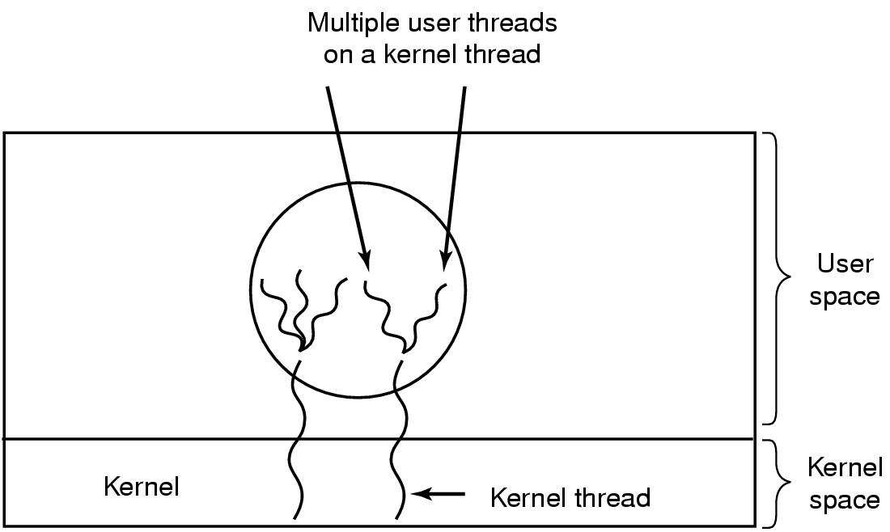
Hybrid Implementations
Multiplexing user-level threads onto kernel- level threads

Slide 47
Hybrid Implementations
Combining the advantages of the 2 methods
the kernel is aware of only the kernel-level threads and schedules those.
,each kernel-level thread has some set of user-level threads that take turns using it.
These user-level threads are created, destroyed, and scheduled just like user-level threads in a process

Slide 48
Thanks for your patience

